Slide 1

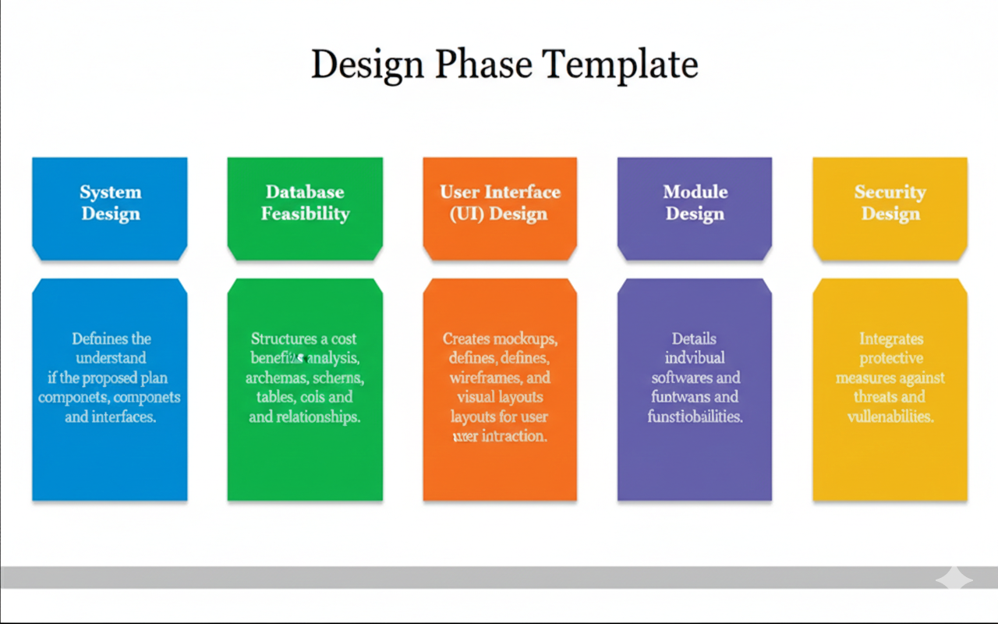
Design Phase Presentation
Food Ordering Service
Project Two Bitcom Group 1 (Year 3)
Silicon Hills, Mile 91
George B Sama (2024023) Com/Sci
Michael G.W.A.J Bangura (2024337) Com/Sci
Mariama Bendu (2024029) BIT
Roland Lansana (2024273) Com/Sci
Arnold Ibrahim Lapo Koroma (2024106) Com/Sci
Ali Kalie Kamara (2024027) BIT
Moriba Sahr Kondeh (2024104) Com/Sci
Mohamed I Bangura (2024123) BIT

Slide 2

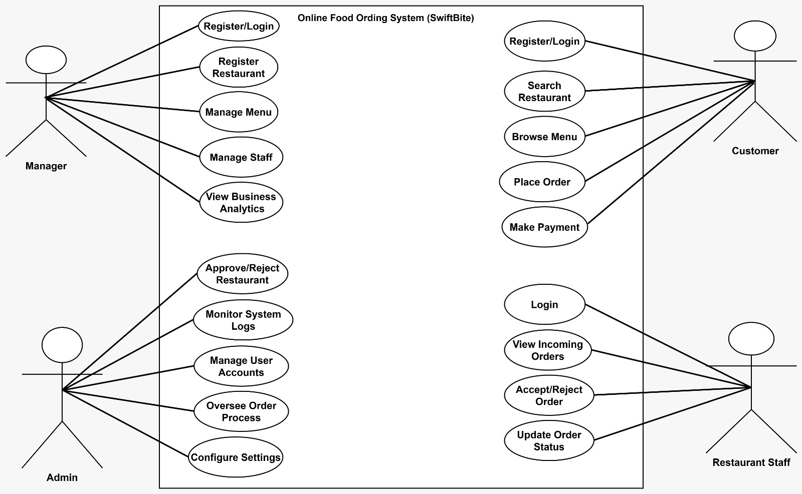
USE CASE DIAGRAM

Slide 3
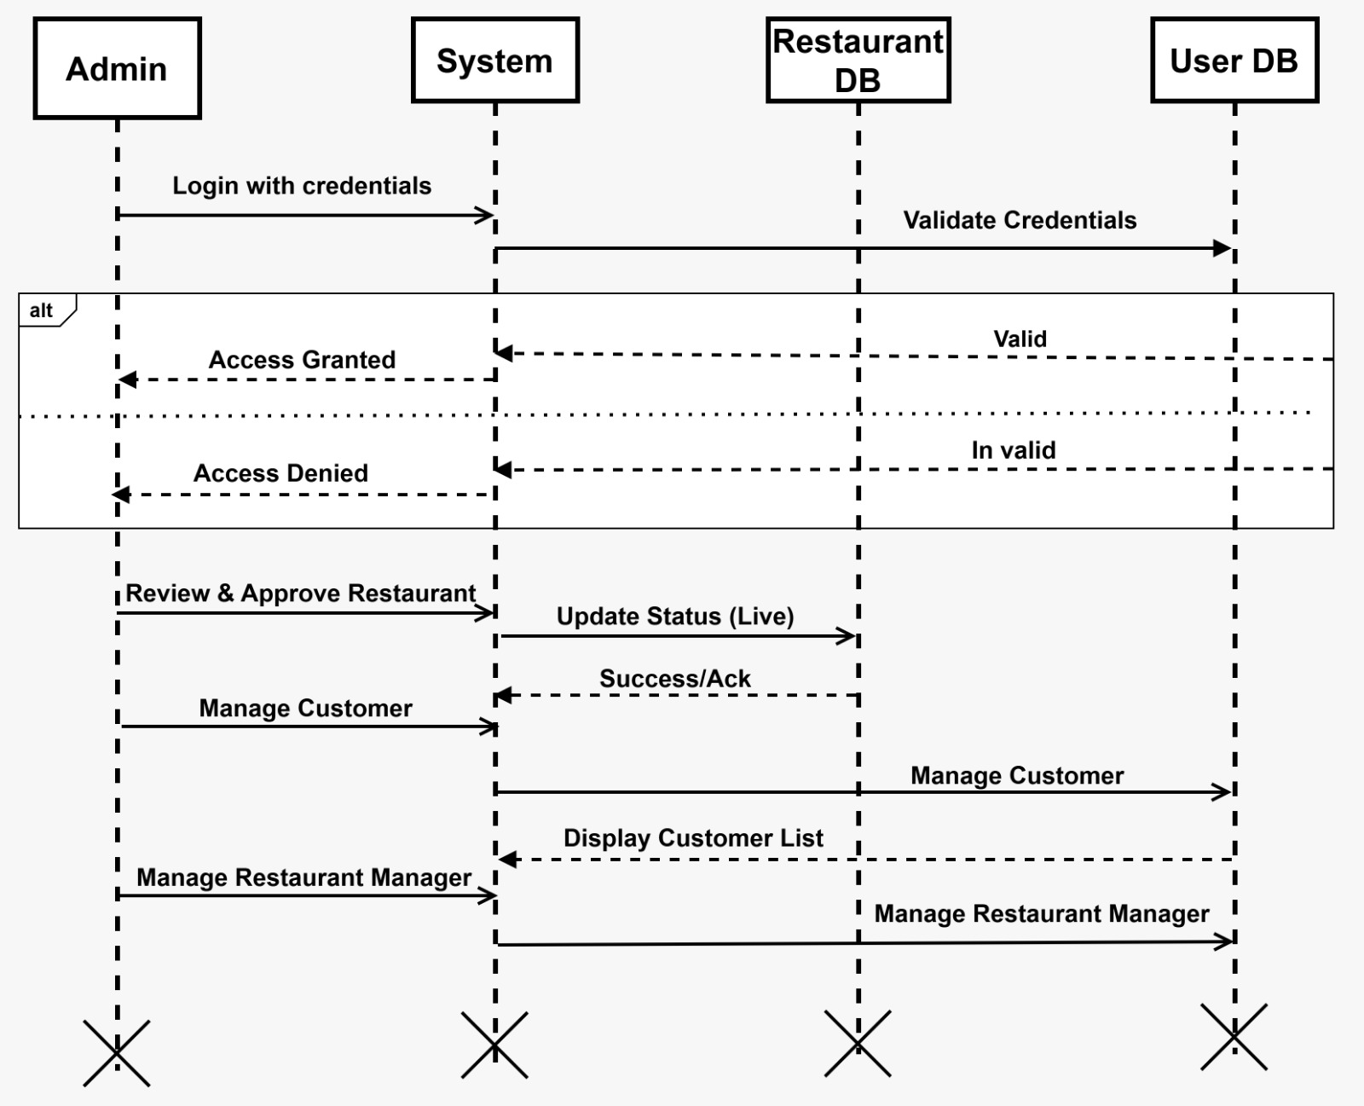
SEQUENCE DIAGRAM ADMIN

Slide 4
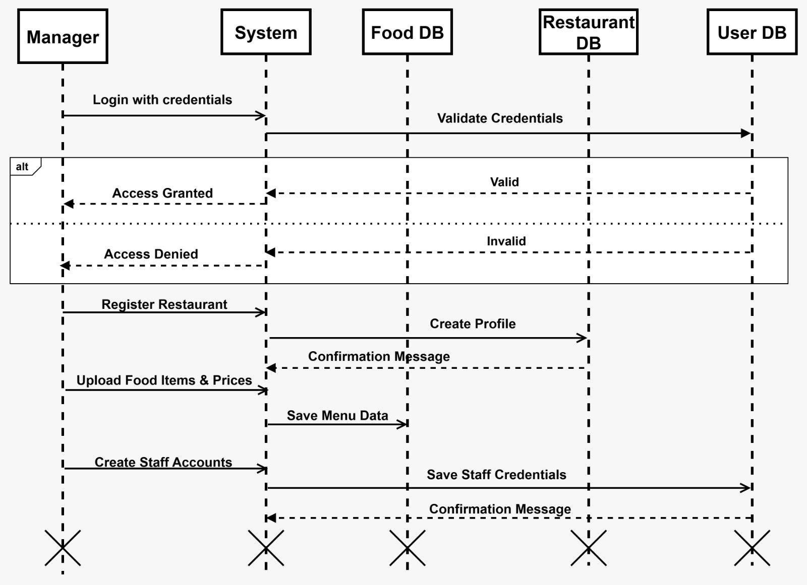
SEQUENCE DIAGRAM MANAGER

Slide 5
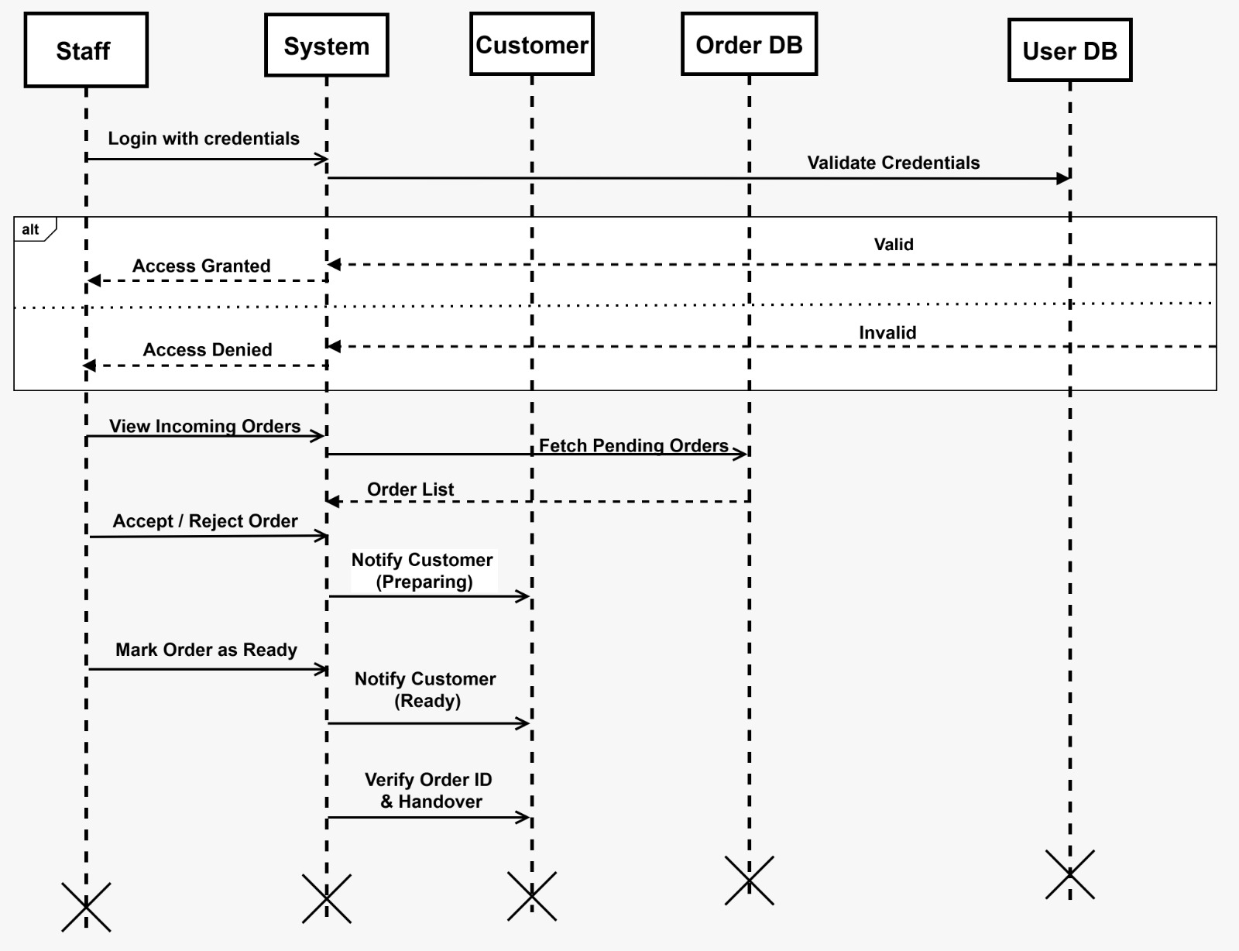
SEQUENCE DIAGRAM STAFF

Slide 6
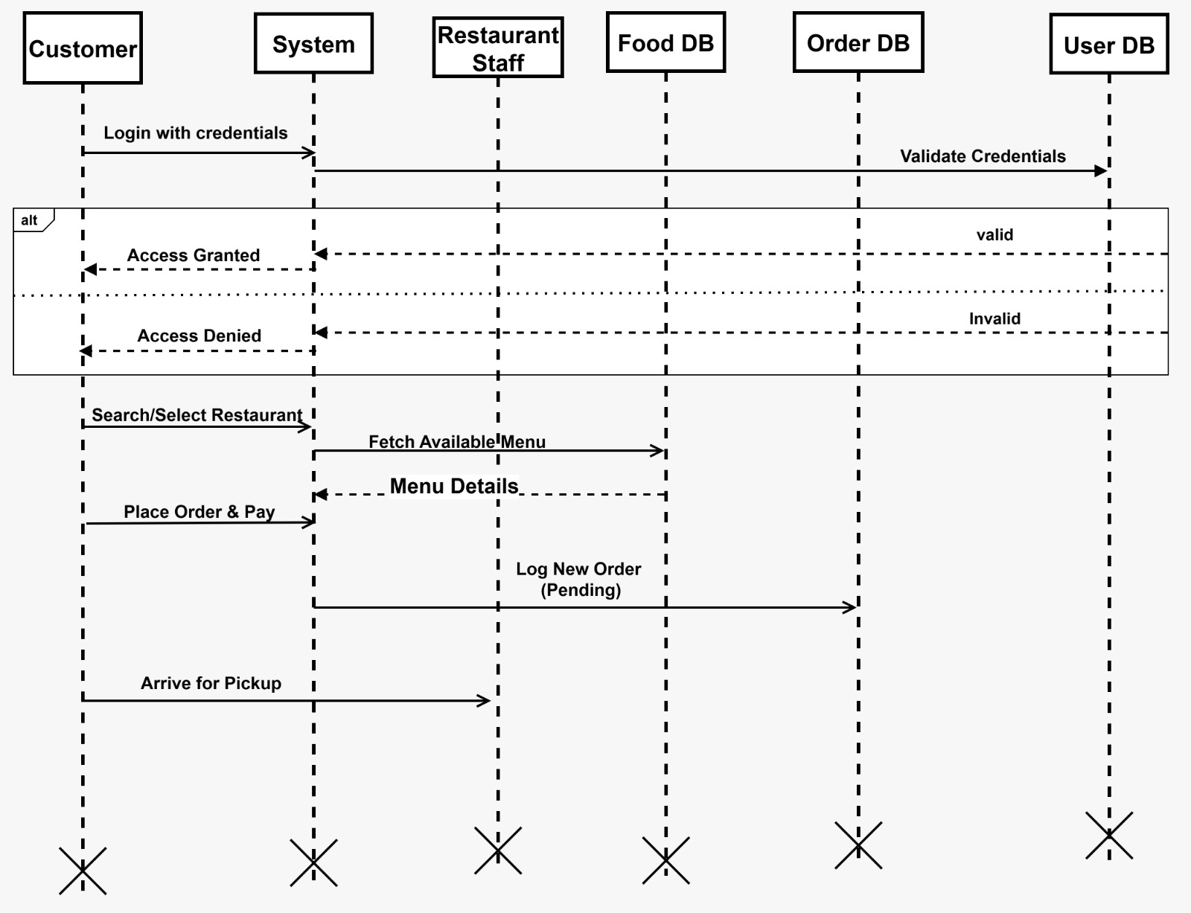
SEQUENCE DIAGRAM CUSTOMER

Slide 7
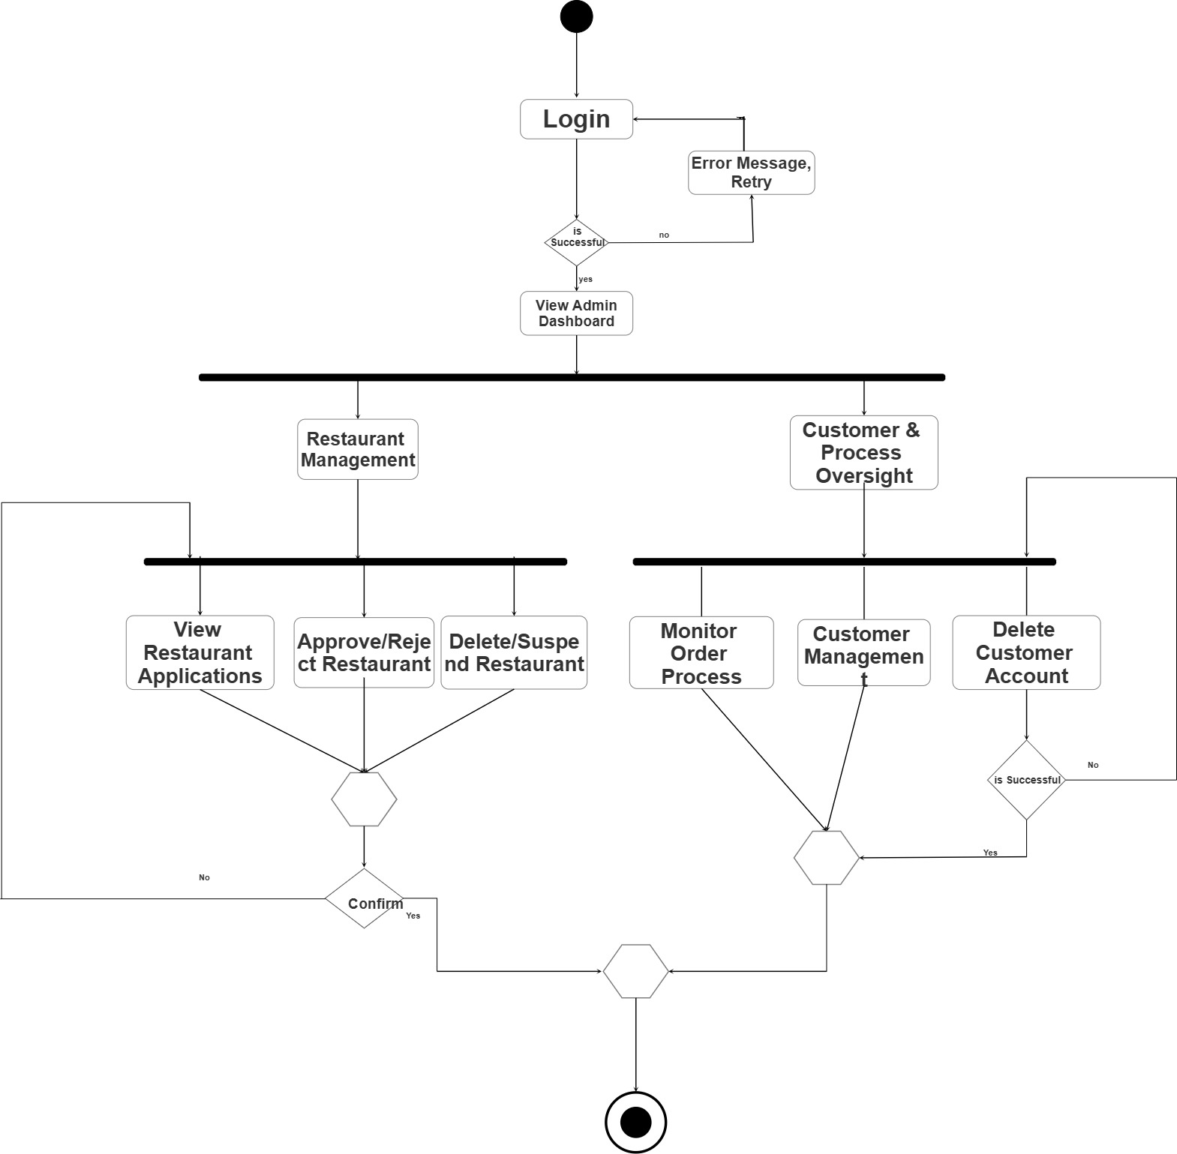
ACTIVITY DIAGRAM ADMIN

Slide 8
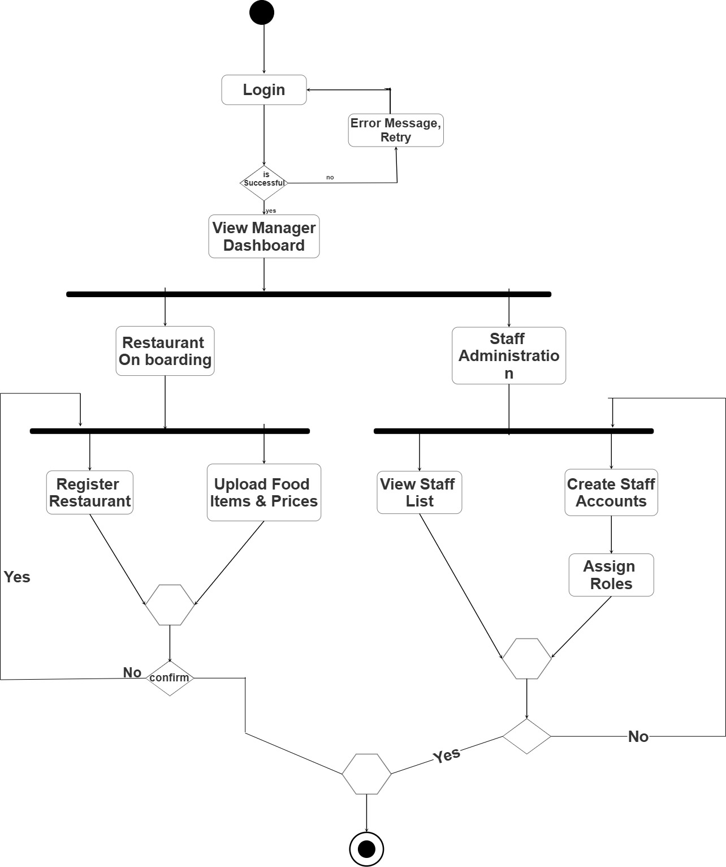
ACTIVITY DIAGRAM MANAGER

Slide 9
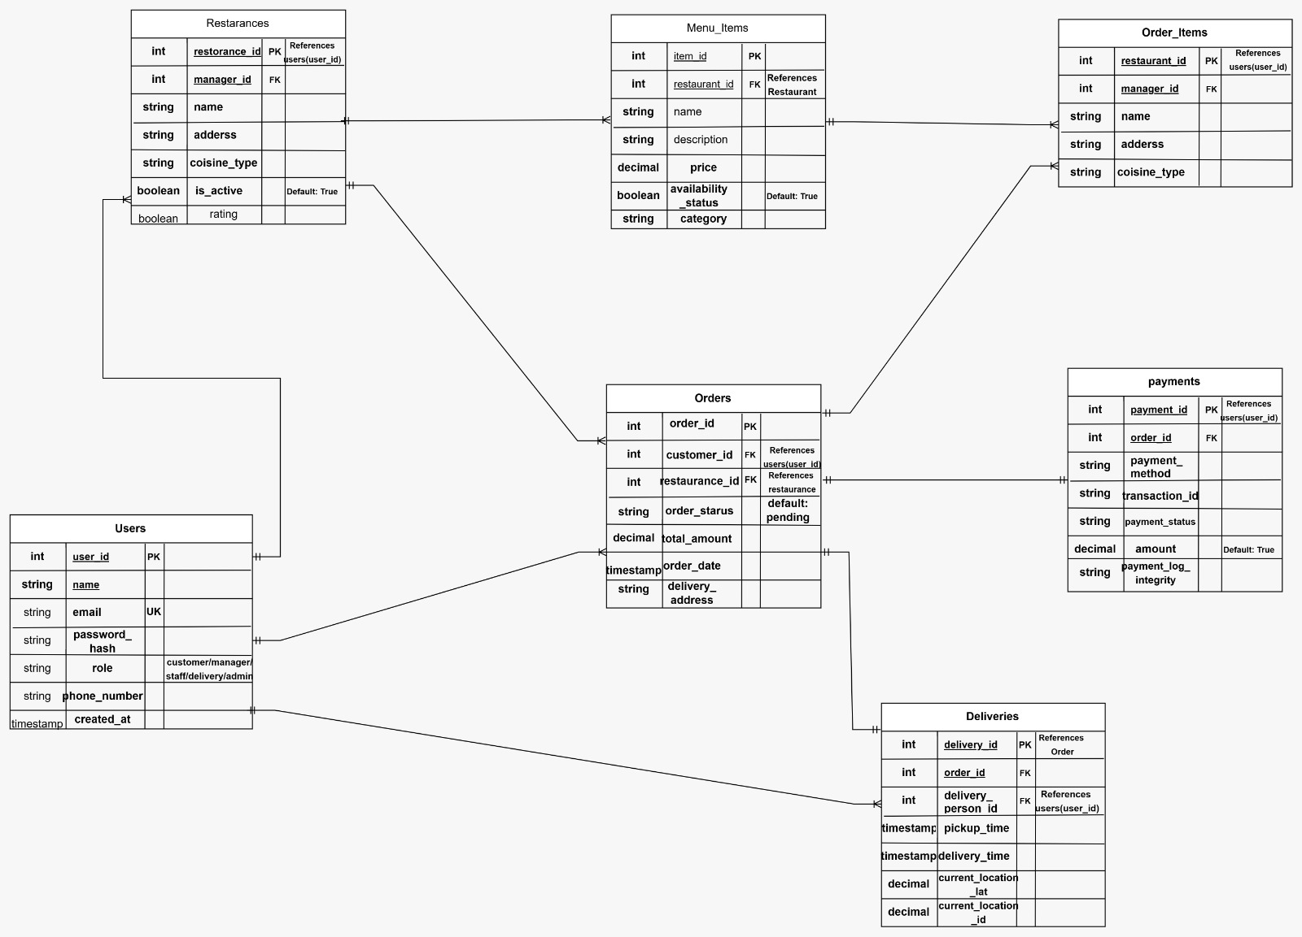
Entity Relationship Diagram

Slide 10
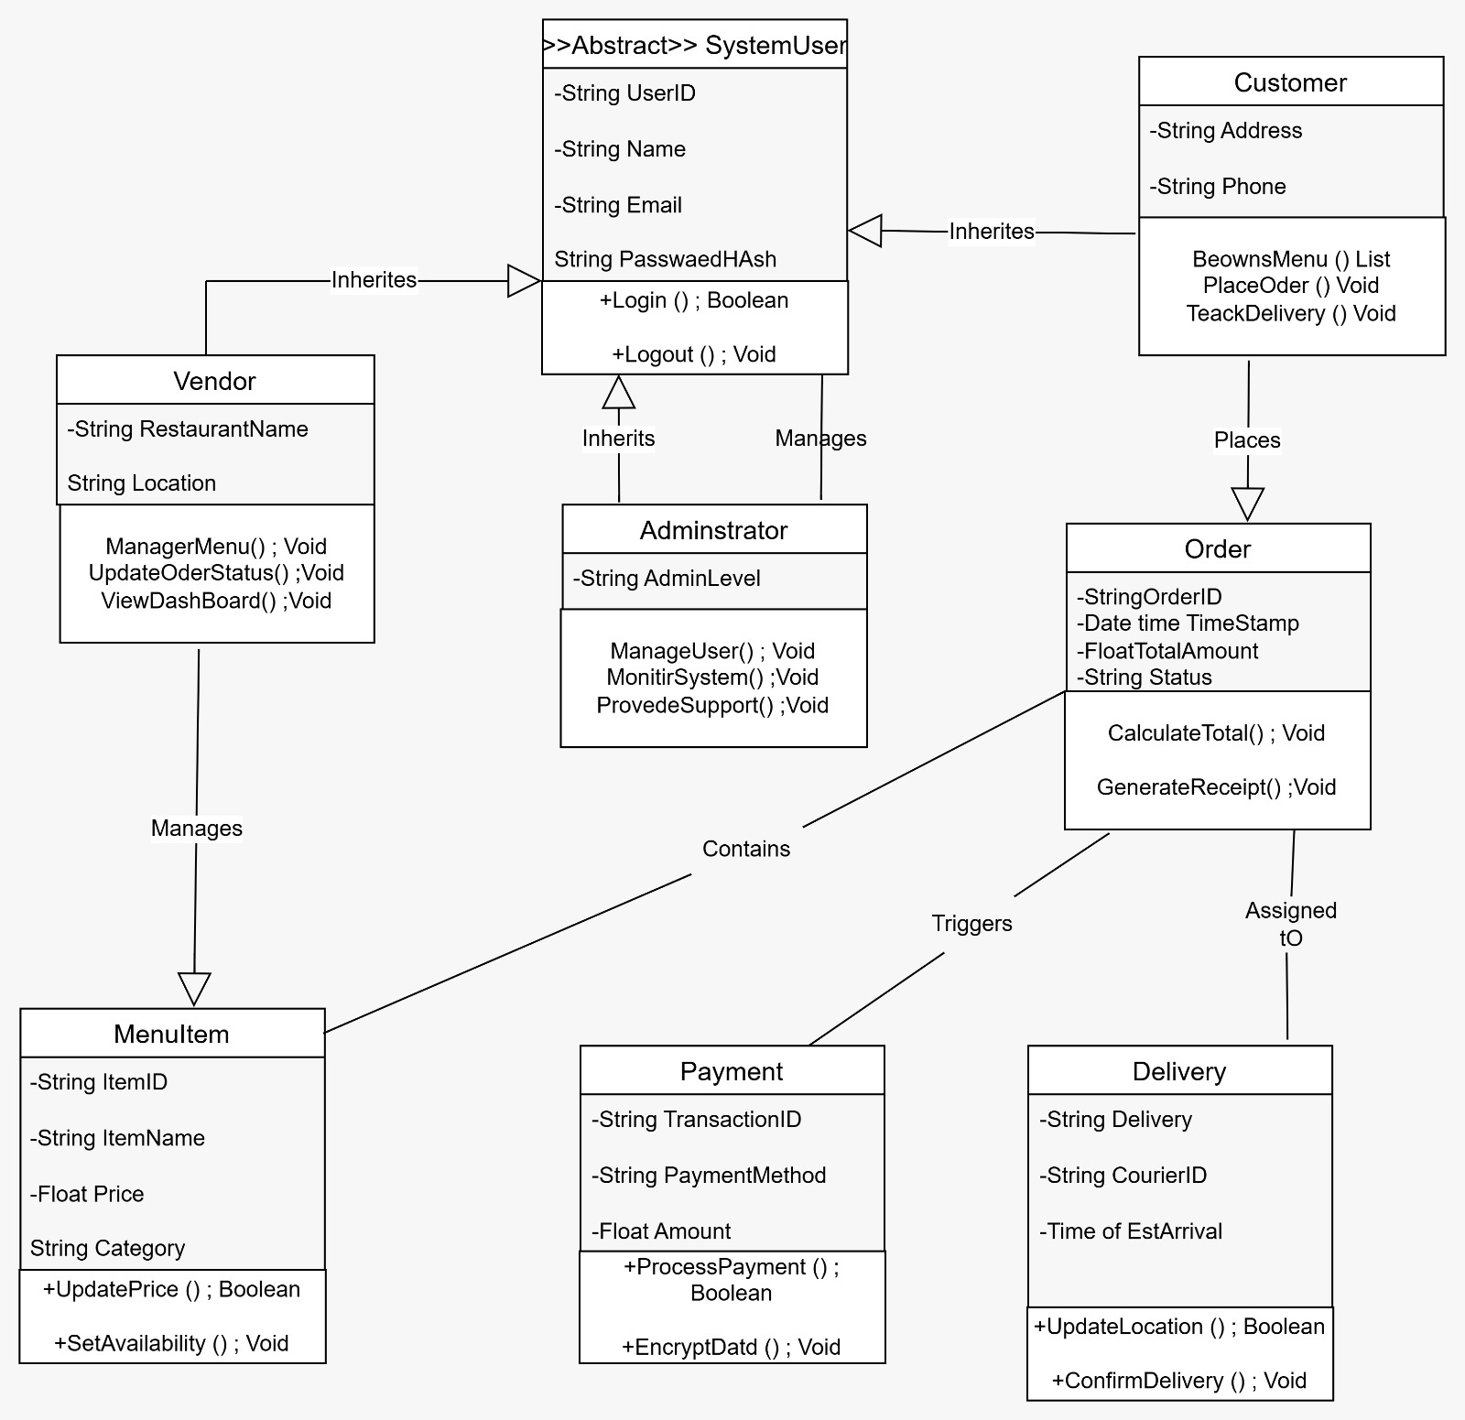
CLASS DIAGRAM

Slide 11
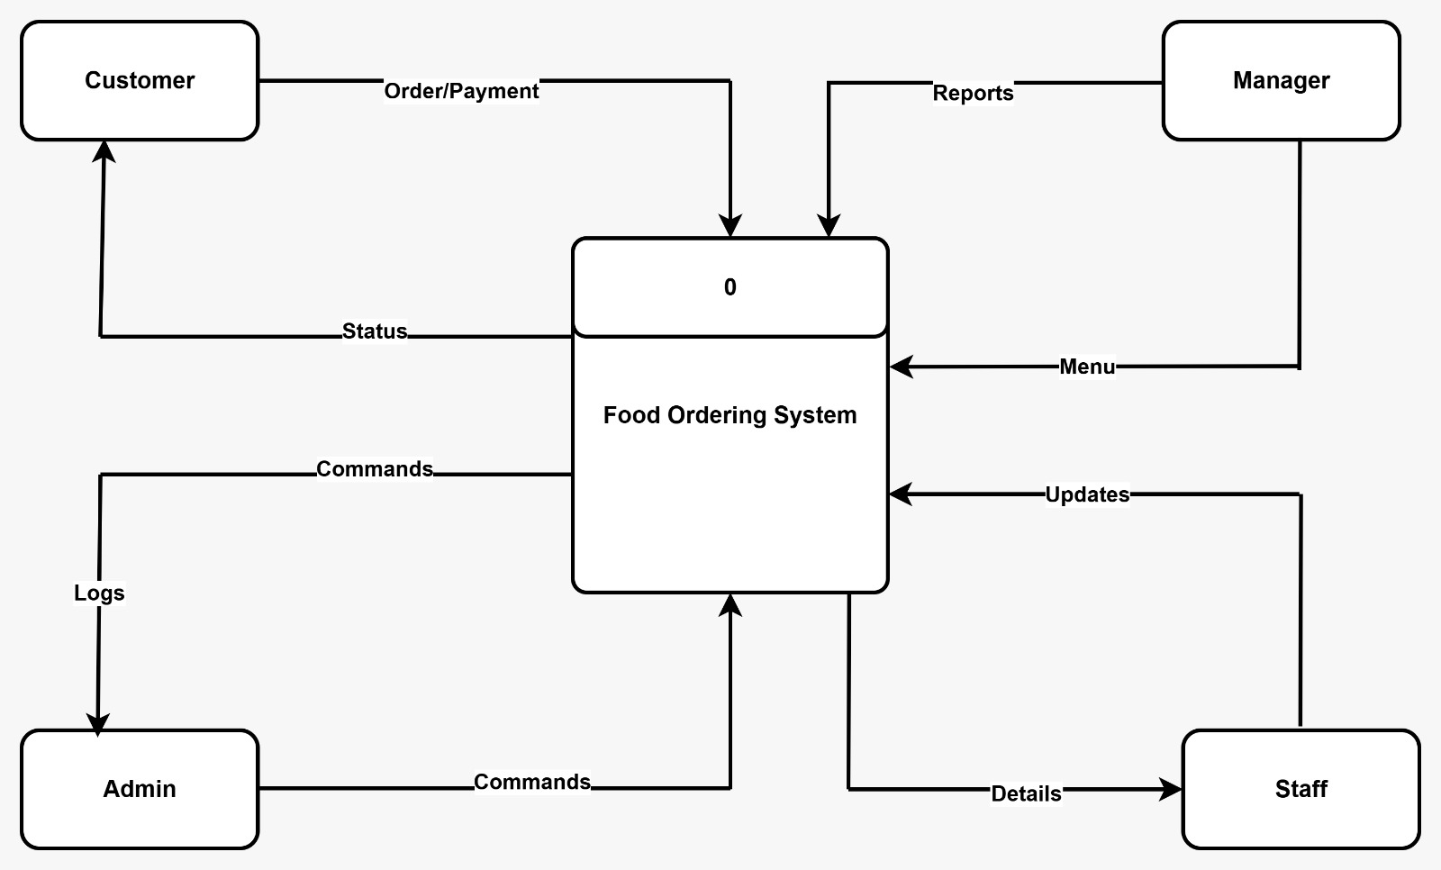
DATAFLOW DIAGRAM LEVEL 0

Slide 12
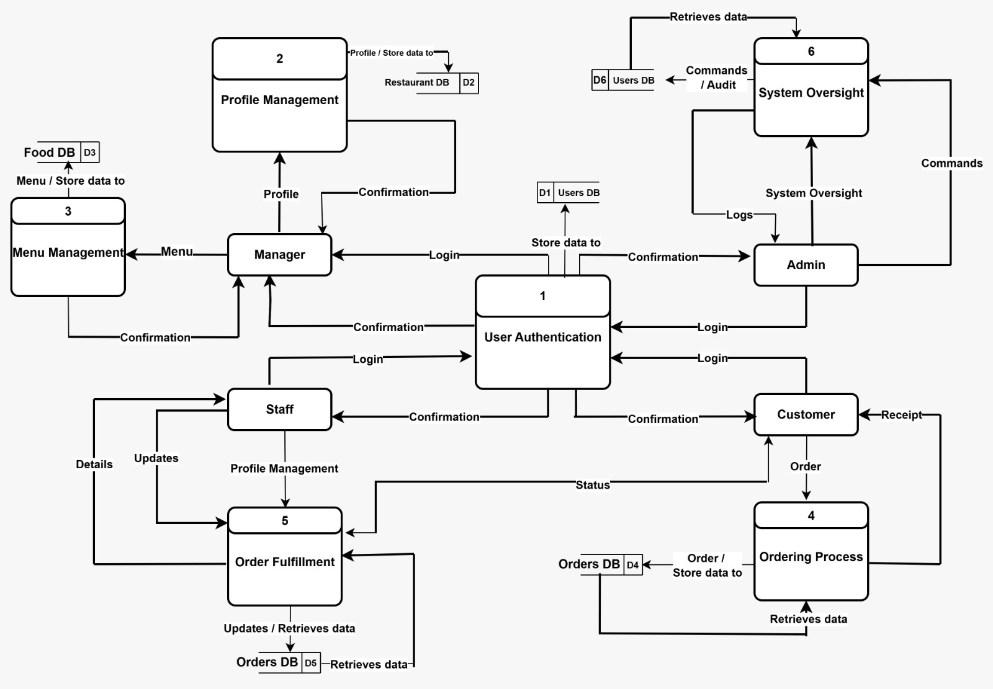
DATAFLOW DIAGRAM LEVEL 1

Slide 13
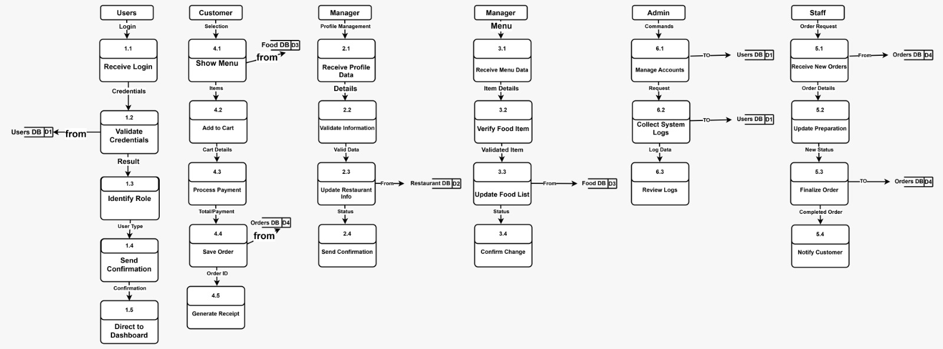
DATAFLOW DIAGRAM LEVEL 2

Slide 14
THANK YOU!

